Slide 1
WELCOME TO

Slide 2
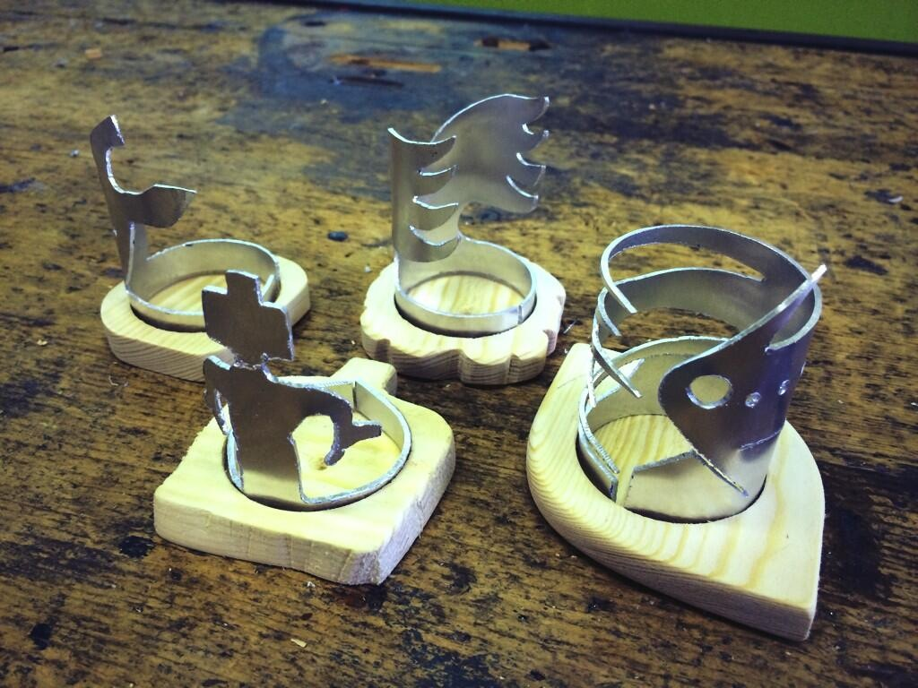
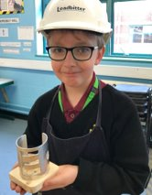
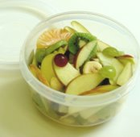
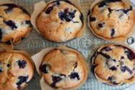
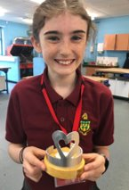
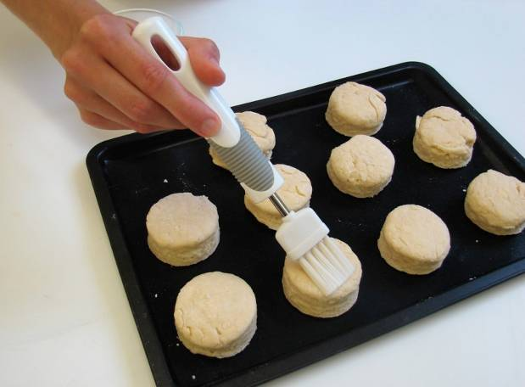
WHAT WILL I LEARN IN DESIGN & TECHNOLOGY?
ENGINEERING
FOOD & NUTRITION
You will make…
Fruit Salad
Cheese Scones
Breakfast Buns
And lots more!!
You will make…
A moodlight
And you will complete…
A range of team challenges!

Slide 3
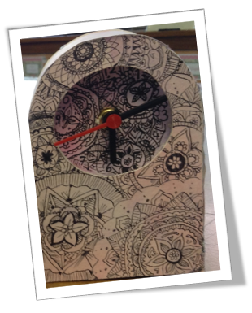
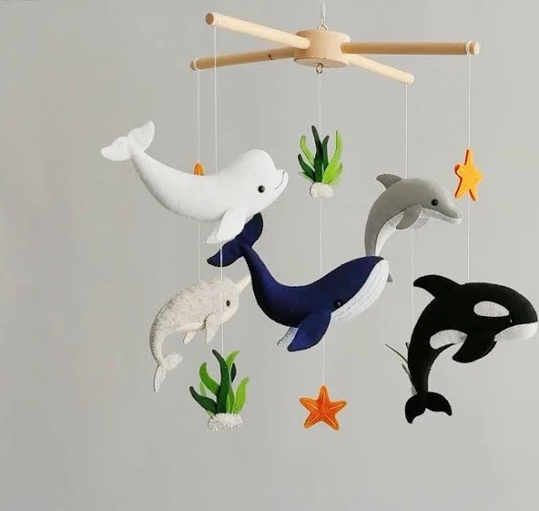
WHAT WILL I LEARN IN DESIGN & TECHNOLOGY?
GRAPHICS
3D DESIGN
You will make…
Chocolate bar packaging
An illustrated clock
You will make…
A windchime based on the theme ‘Under the Sea’

Slide 4
DT SOCIAL MEDIA
If your parents have social media, they can follow us to see examples of your work!
@RWBA_DT
Instagram requires everyone to be at least
13 years old before they can create an account.

