Slide 1
ROYAL WOOTTON BASSETT ACADEMY
DESIGN AND TECHNOLOGY
KEY STAGE 4

Slide 2
COURSES ON OFFER
FOOD
PREPARATION
AND NUTRITION
ART AND DESIGN
3D DESIGN
ART AND DESIGN
GRAPHIC
COMMUNICATION
TECHNICAL
AWARD
ENGINEERING

Slide 3
AQA FOOD, PREPARATION AND NUTRITION
MISS REVELL

Slide 4
NEA 1 Food
Investigation (15%)
NEA 2 Food Preparation
Assessment (35%)
Examination
paper (50%)
20 HOURS. THIS INCLUDES A 3 HOUR PRACTICAL SESSION TO MAKE YOUR THREE FINAL DISHES
1hr 45 mins
TIME ALLOWED
NO MORE THAN 10 HOURS
1500 – 2000 WORDS. THIS WILL INCLUDE GRAPHS, CHARTS, PRACTICAL RESULTS, ANNOTATION.
PORTFOLIO INCLUDING PHOTOGRAPHIC EVIDENCE OF ALL 3 DISHES. THE REPORT WILL BE NO MORE THAN 20 SIDES OF A4.
LENGTH OF TASK
ANSWER ALL QUESTIONS
TWO YEAR COURSE OVERVIEW
ASSESSMENT= 2 PIECES OF COURSEWORK (50%) AND 1 EXAM (50%)
RELEASE DATE
NEA 1 IS RELEASED SEPTEMBER OF YEAR 11
NEA 1 IS RELEASED NOVEMBER OF YEAR 11
SET BY EXAM BOARD
NEA 1 IS MARKED OUT OF 30 AND COUNTS FOR 15% OF YOUR GCSE GRADE
NEA 2 IS MARKED OUT OF 70 AND COUNTS FOR 35% OF YOUR GCSE GRADE
ASSESSMENT DETAILS
50% OF YOUR GCSE GRADE
A: RESEARCH: 6 MARKS
B: INVESTIGATION: 15 MARKS
C: ANALYSIS & EVALUATION:
9 MARKS
TOTAL: 30 MARKS
A: RESEARCH: 6 MARKS
B: DEMONSTRATE TECHNICAL SKILLS: 18 MARKS
C: PLANNING FOR THE FINAL MENU: 8 MARKS
D: MAKING THE FINAL DISHES: 30 MARKS
E: ANALYSIS AND EVALUATION: 8 MARKS
TOTAL: 70 MARKS
100 MARKS
SECTION A: 20 MARKS MULTIPLE CHOICE
SECTION B: 80 MARKS VARIOUS STYLE AND LENGTH
ASSESSMENT BREAKDOWN

Slide 5
WHAT THEORY WILL YOU LEARN IN YEAR 10?
YOU WILL LEARN WHY THE BODY NEEDS CERTAIN TYPES OF FOODS AND WHAT HAPPENS IF THE BODY HAS TOO LITTLE OR TOO MUCH.
SECTION 1: FOOD, NUTRITION AND HEALTH
SECTION 2: FOOD SCIENCE
SECTION 3: FOOD SAFETY
SECTION 4: FOOD CHOICE
SECTION 5: FOOD PROVENANCE

Slide 6
YEAR 10 PRACTICALS
MUFFINS
FISH FINGERS
OR
CHICKEN NUGGETS
COTTAGE PIE
BREAD ROLL
OR
NAAN BREAD
WITH
RHITA DIP
01
03
05
07
FAT
EXPERIMENT
SUGAR
EXPERIMENT
HEATING
METHODS
02
04
06

Slide 7
YEAR 10 PRACTICALS
FRY-UP
PRACTICAL
EXPERIMENT
LEMON
MERINGUE
PIE
OR
QUICHE
PASTA
EXPERIMENT
CHOUX PASTRY
08
10
12
14
CHICKEN CURRY
CHICKEN
DISSECTION
FILLETING
A FISH
09
11
13

Slide 8
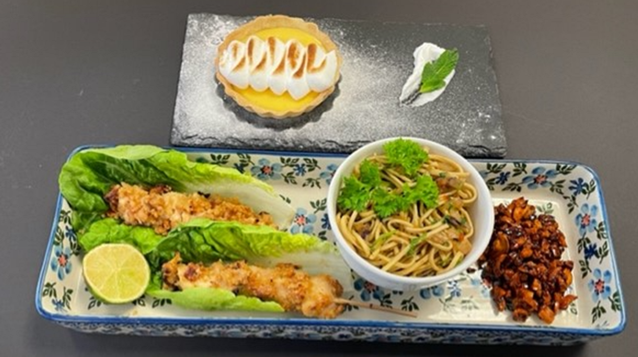
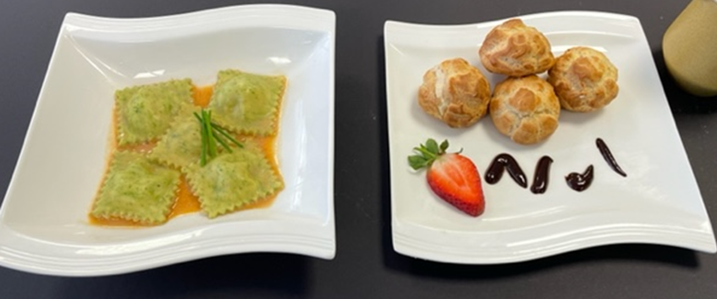
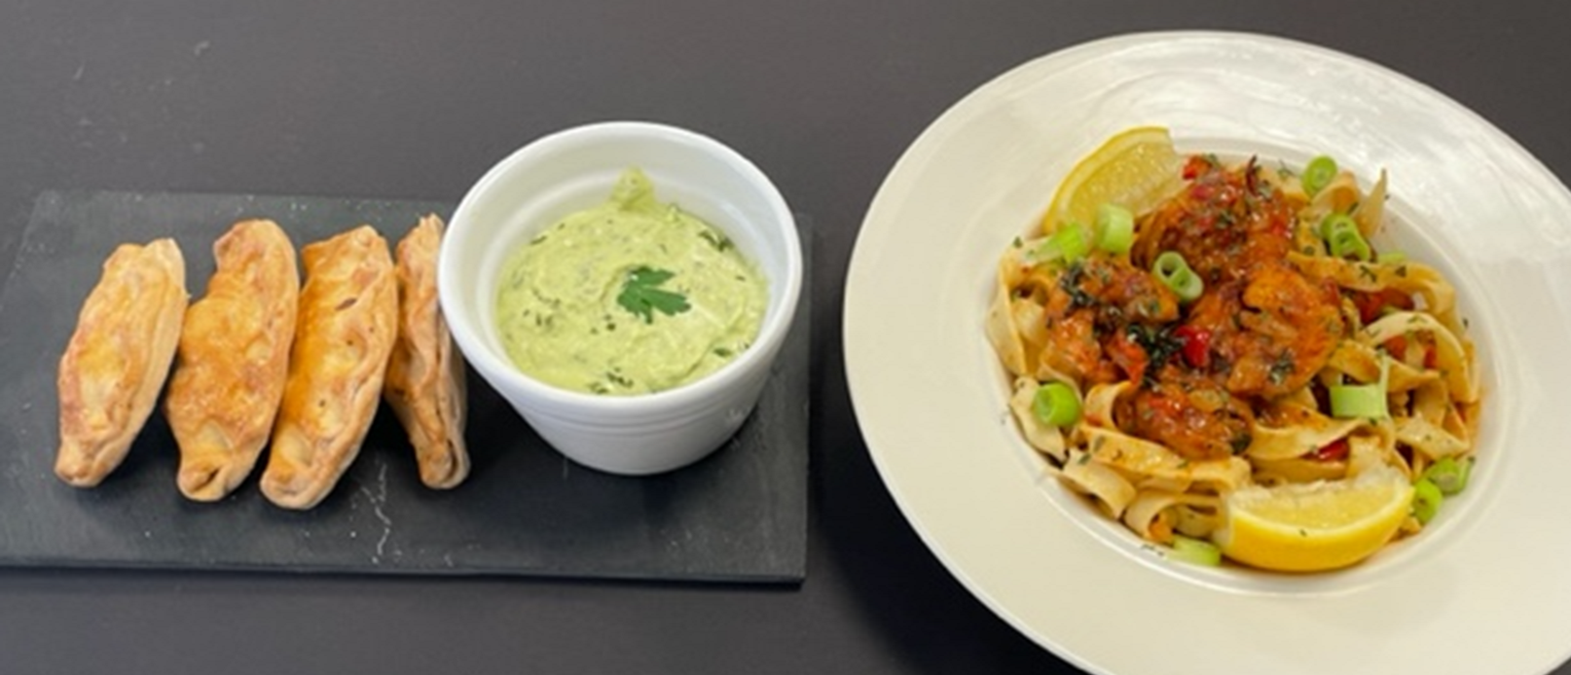
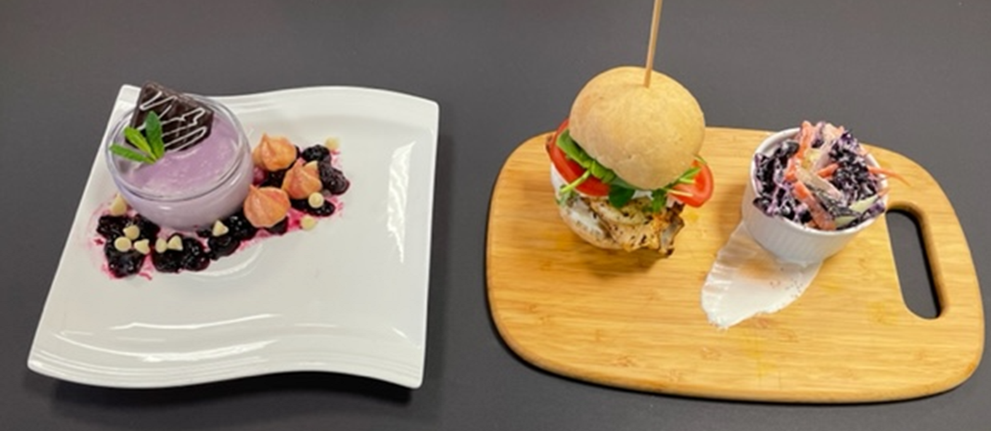
EXEMPLAR WORK

Slide 9
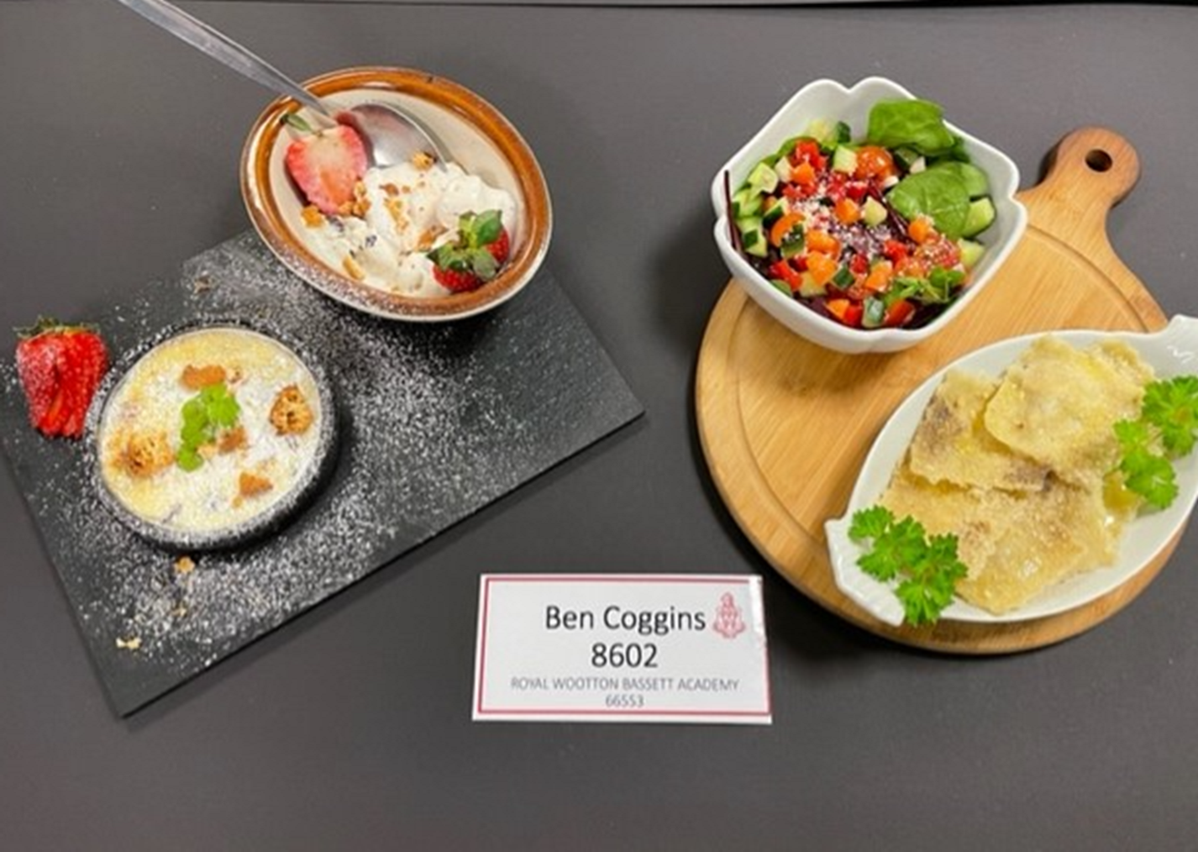
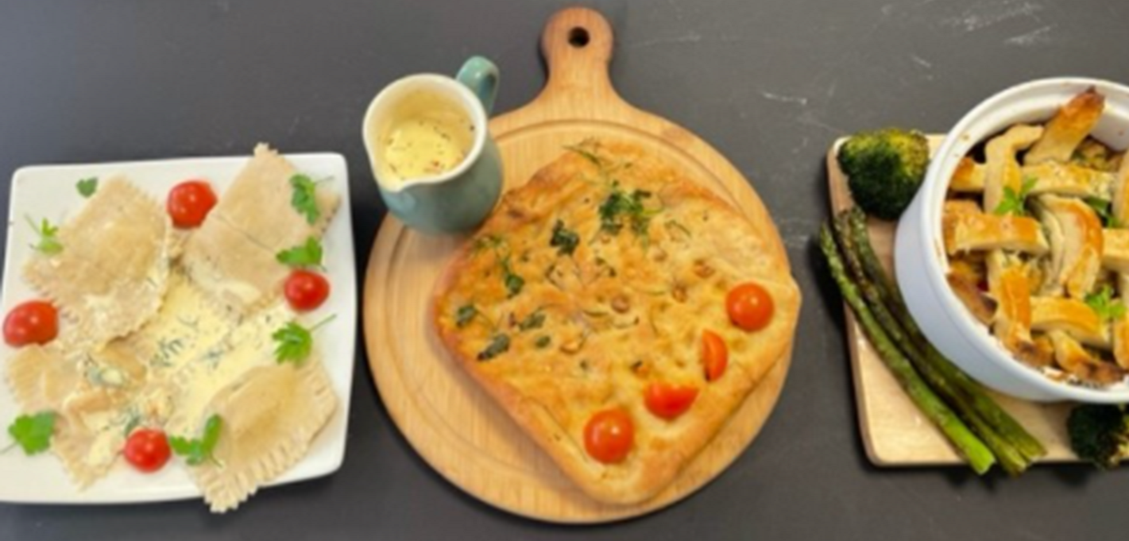
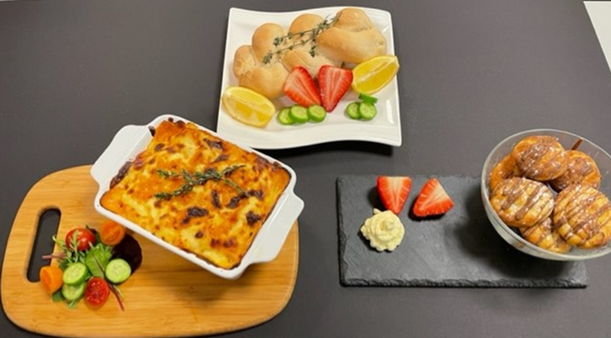
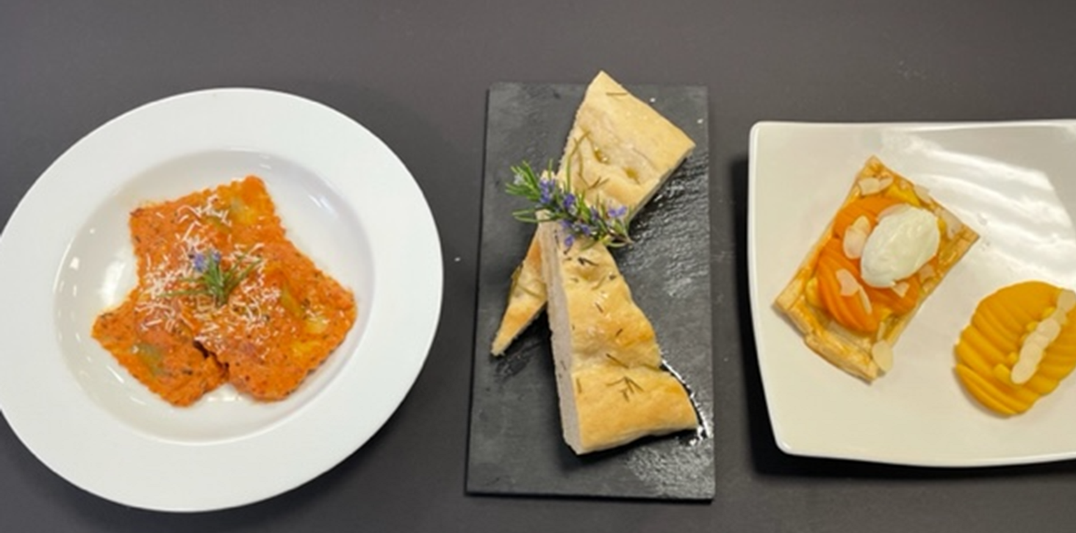
EXEMPLAR WORK

Slide 10
STUDENT QUOTES
“I LOVE THE RNAGE OF PRACTICALS AND THE IDEAS
THAT WE ARE ALLOWED TO TRY AND EXPERIMENT WITH.”
“THE CONTENT IS SO INTERESTING AND MATCHED
WITH THE SKILLS WE LEARN MEANS THIS IS MY FAVOURITE
SUBJECT.”
“I WANT TO BE A CHEF WHEN I’M OLDER AND THIS COURSE
IS FULLY PREPARING ME FOR THAT. I LOVE THE PRACTICALS
AND FEEL PROUD TO TAKE MY FOOD HOME.”

