Slide 1
WJEC – VOCATIONAL AWARD IN ENGINEERING
MRS DAY, MISS PAYNE,
MR BENNETT AND MRS ALFORD

Slide 2
INTRODUCTION
ENGINEERING IS A DRIVING FORCE IN THE UK’S ECONOMY, ACCOUNTING FOR 21.4% (£1.2 TRILLION) OF THE
UK’S £5.7 TRILLION TURNOVER IN 2018. HOWEVER, THERE IS A CONSIDERABLE SHORTAGE OF
APPROPRIATELY SKILLED WORKERS IN THE ENGINEERING SECTOR.
ONE OF THE REASONS FOR THIS IS DUE TO A LACK OF AWARENESS AMONG YOUNG PEOPLE OF THE
EDUCATIONAL ROUTES INTO ENGINEERING OCCUPATIONS, DESPITE THE FACT THAT PURSUING STEM SUBJECTS
REMAINS A PRIORITY FOR MANY YOUNG PEOPLE, AND, ACCORDING TO ENGINEERING UK ,
THE PROPORTION OF YOUNG PEOPLE AGED 11 TO 14 WHO SAID THEY WOULD
CONSIDER A CAREER IN ENGINEERING WAS 54.7% IN 2019.

Slide 3
COURSE STRUCTURE
UNIT 1 MANUFACTURING ENGINEERING PRODUCTS (40% OF FINAL GRADE)
YEAR 10
INTERPRET DIFFERENT TYPES OF ENGINEERING INFORMATION IN ORDER TO PLAN HOW TO MANUFACTURE ENGINEERING PRODUCTS, USING A RANGE OF ENGINEERING TOOLS AND EQUIPMENT IN ORDER TO MANUFACTURE AND TEST AN END PRODUCT
UNIT 2 DESIGNING ENGINEERING PRODUCTS (20% OF FINAL GRADE)
YEAR 10
EXPLORE HOW AN ENGINEERED PRODUCT IS ADAPTED AND IMPROVED OVER TIME, AND APPLY YOUR KNOWLEDGE AND UNDERSTANDING TO ADAPT AN EXISTING COMPONENT, ELEMENT OR PART OF THE ENGINEERING OUTCOME THAT WAS MANUFACTURED FOR UNIT 1
UNIT 3 SOLVING ENGINEERING PROBLEMS (40% OF FINAL GRADE)
YEAR 11
RANGE OF CONSIDERATIONS THAT IMPACT ON ENGINEERING DESIGN AND HOW MODERN ENGINEERING HAS HAD AN IMPACT ON MODERN DAY LIFE AT HOME, WORK AND IN SOCIETY IN GENERAL

Slide 4
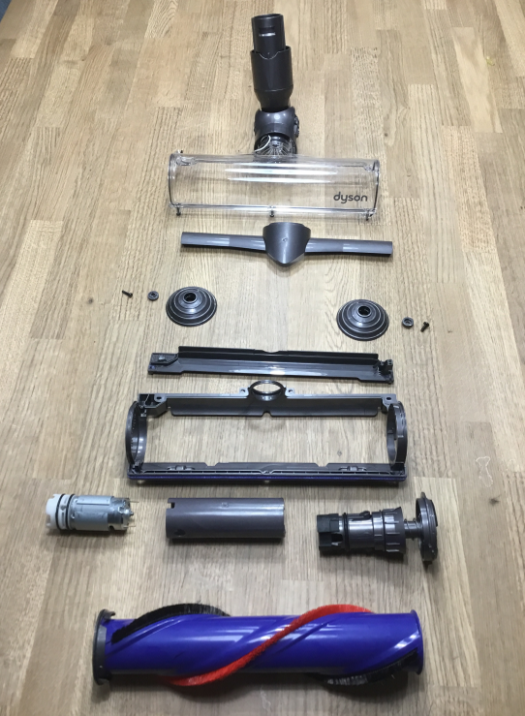
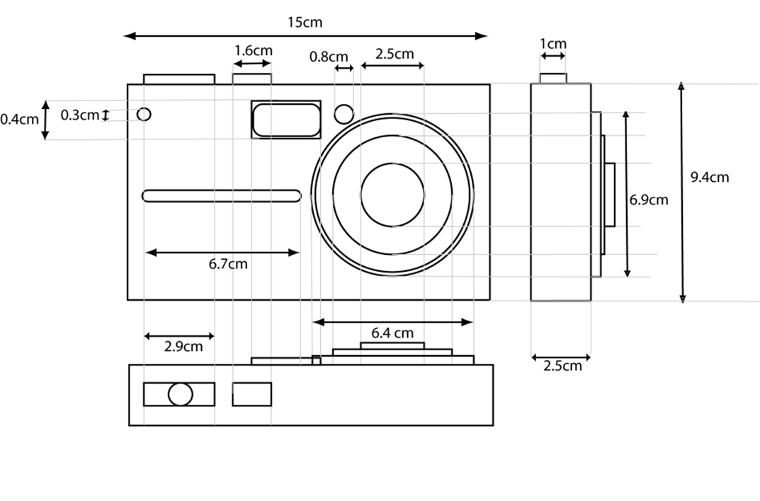
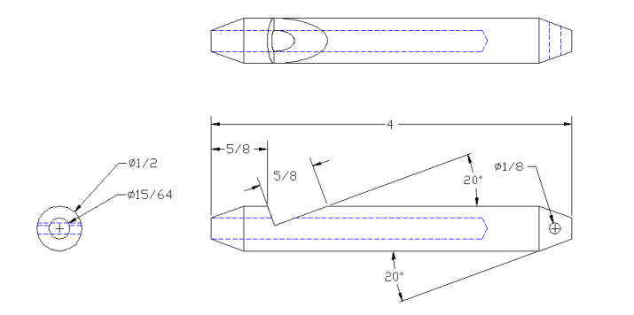
EXEMPLAR WORK

Slide 5
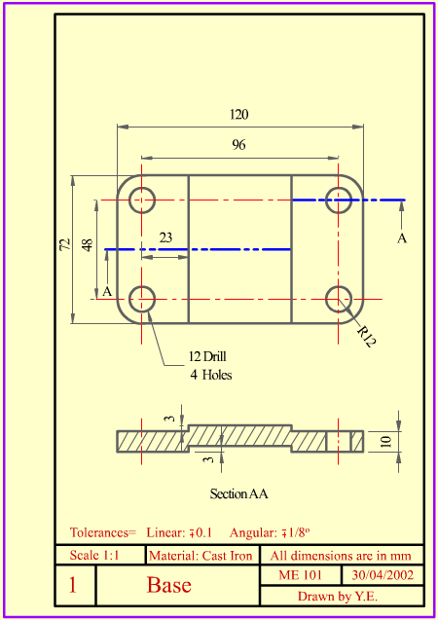
EXEMPLAR WORK

Slide 6
ASSESSMENT GRADES
LEVEL 2 DISTINCTION STAR
LEVEL 2 DISTINCTION
LEVEL 2 MERIT
Candidates who do not achieve the uniform marks required to achieve a Level 1 Pass will have their achievement recorded as U and will not receive a certificate
LEVEL 2 PASS
LEVEL 1 DISTINCTION
LEVEL 1 MERIT
LEVEL 1 PASS

Slide 7
STUDENT QUOTES
“THE LINKS TO REAL-LIFE BRIEFS SHOW US HOW WE
CAN TAKE THE SKILLS WE ARE LEARNING AND APPLY THEM
IN A REAL WORKSHOP.”
“THE EQUIPMENT AND TOOLS ARE USED IN SUCH DIFFERENT
WAYS, IT REALLY HELPS YOU TO PROBLEM SOLVE AND
MAKE THINGS YOU DIDN’T KNOW YOU WERE CAPABLE OF.”
“EASILY MY FAVOURITE SUBJECT. THE TEACHERS REALLY
HELP YOU AND GIVE GREAT DEMONSTRATIONS TO HELP
YOU MAKE PROFESSIONAL LOOKING PRODUCTS.”

