Slide 1
OCR ART & DESIGN –
THREE DIMENSIONAL DESIGN
MR BENNETT

Slide 2
EXPECTATIONS
KEEP A DESIGN JOURNAL
UP TO DATE –
REVIEWED REGULARLY
EVERY 2 TO 3 WEEKS
TO WORK SAFELY AND WITH
RESPECT FOR EACH
OTHER IN THE WORKSHOP
PUT EFFORT INTO PRODUCING
YOUR IDEAS INTO
3D DESIGNS,
MAKING YOUR WORK TO THE
HIGHEST STANDARD POSSIBLE
IF YOU HAVE ANY ISSUES,
TO SPEAK TO ME ABOUT IT
AS SOON AS POSSIBLE

Slide 3
COURSE OVERVIEW
SCULPTURAL AND ARCHITECTURAL DESIGN
ARCHITECTURE AND INTERIOR DESIGN
YEAR 9 TERM 6
SLAB OF SKILLS
YEAR 10
JEWELLERY DESIGN
PRODUCT DESIGN

Slide 4
ASSESSMENT OUTCOMES
1
3
2
4
DEVELOP IDEAS
THROUGH INVESTIGATIONS,
SHOWING UNDERSTANDING
OF SOURCES
RECORD IDEAS,
OBSERVATIONS AND INSIGHTS
RELEVANT TO INTENTIONS
THIS MEANS RESEARCH.
MAKING NOTES ON YOUR RESEARCH TO SHOW YOU HAVE EVALUATED AND ANALYSED IT
KEEPING A JOURNAL , MAKING A RECORD OF YOUR THOUGHTS.
REFINE WORK BY EXPLORING IDEAS,
SELECTING AND EXPERIMENTING
WITH APPROPRIATE MEDIA MATERIALS AND TECHNIQUES
PRESENT A PERSONAL AND MEANINGFUL
RESPONSE THAT REALISES
INTENTIONS SHOWING AN
UNDERSTANDING OF
VISUAL LANGUAGE
THIS MEANS PRODUCING A RANGE OF IDEAS THROUGH DRAWING AND MAKING.
CLEARLY LINKING WHAT YOU'RE MAKING TO THINGS YOU HAVE RESEARCHED.
MAKING A FINISHED FINAL OBJECT THAT IS MADE WELL AND SHOWS SKILLS AND KNOWLEDGE

Slide 5
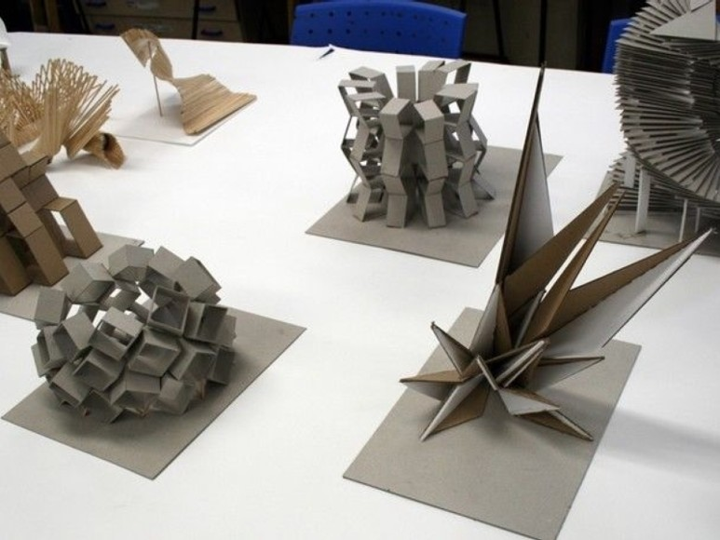
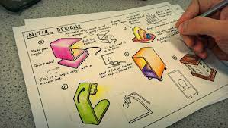
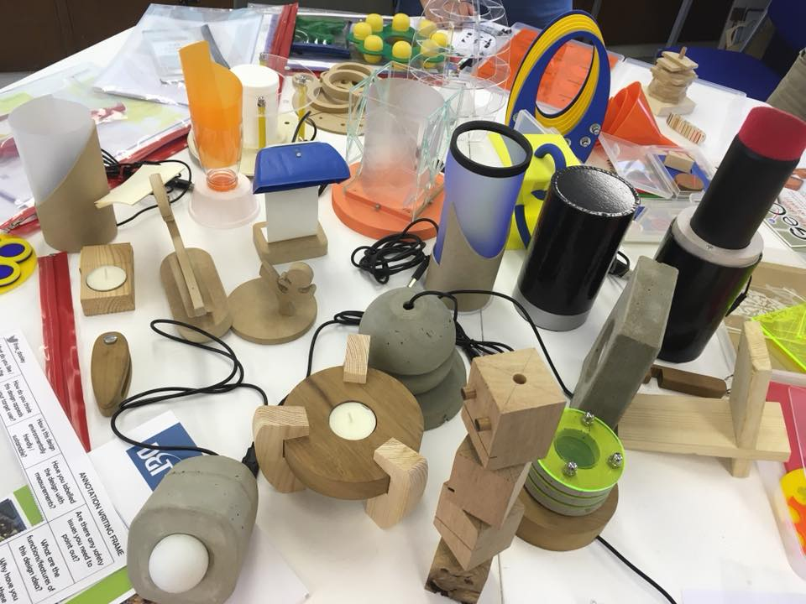
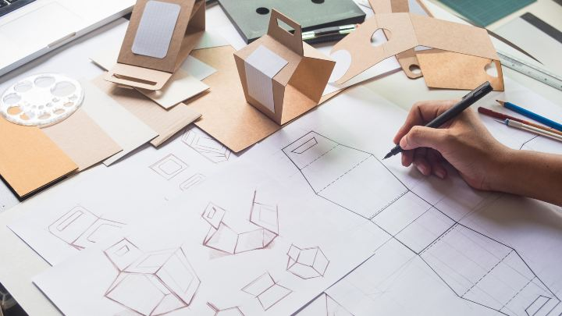
EXEMPLAR WORK

Slide 6
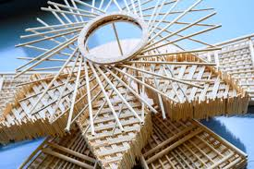
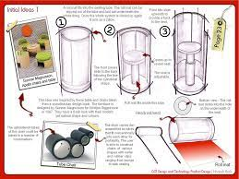
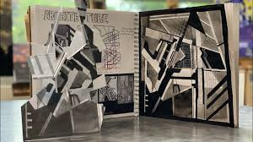
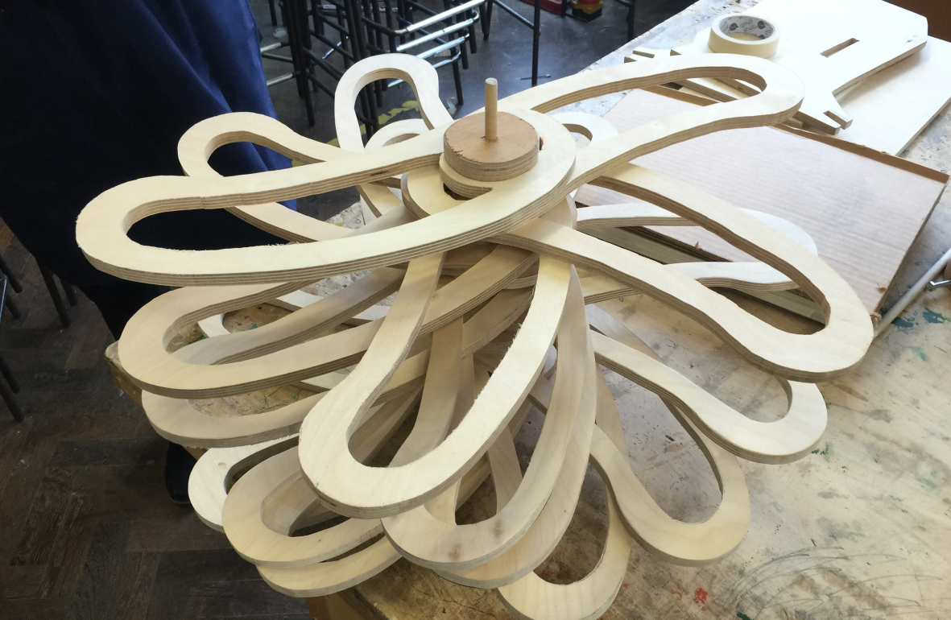
EXEMPLAR WORK

Slide 7
STUDENT QUOTES
“WE GET TO STUDY A GREAT RANGE OF DESIGNERS
AND I FEEL INSPIRED TO BE AS CREATIVE AS POSSIBLE.”
“WE HAVE SUCH A WIDE CHOICE OF THINGS WE CAN DESIGN
AND GET HELP AND GUIDANCE ALONG THE WAY TO
PRODUCE OUR BEST.”
“THE DESIGNS WE STUDY, AND HOW THEY INFLUENCE
OUR IDEAS, MEANS THAT WE CAN BE HIGHLY CREATIVE.”

